Slide 1
Lecture 13
CSE 3203
Topic Forward and Backward Chaining

Slide 2
Introduction
Backward and forward chaining are methods of reasoning that exist in the Expert System Domain of artificial intelligence. These techniques are used in expert systems such as MYCIN and DENDRAL to generate solutions to real life problems. MYCIN uses the backward chaining technique to diagnose bacterial infections. DENDRAL employs forward chaining to establish the structure of chemicals.

Slide 3
Introduction
Reasoning: Reasoning is the process of using existing knowledge to draw conclusions, make predictions, or construct explanations. It is a general process of thinking rationally (in a sensible or logical manner), to find valid conclusions. In artificial intelligence, the reasoning is essential so that the machine can also think rationally as a human brain, and can perform like a human. (Review)

Slide 4
Continue
There are three components in an expert system: user interface, inference engine, and knowledge base. The user interface enables users of the system to interact with the expert system. High-quality and domain-specific knowledge is stored in the knowledge base.
Inference Engine: The inference engine applies logical rules to the knowledge base and deduced new knowledge. (Review)

Slide 5
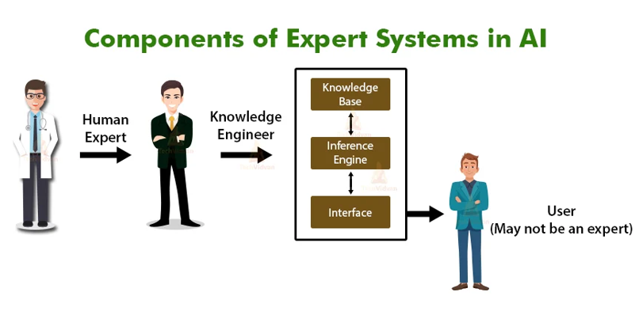
Continue

Slide 6
Continue
Forward Chaining and Backward Chaining are the two most important strategies in the field of Artificial Intelligence and lie in the Expert System Domain of AI. Forward and Backward chaining is the strategies used by the Inference Engine in making the deductions (the process of deriving new facts or theorems from known facts and axioms). in the Expert system.
Axioms: A statement or principle that is generally accepted to be true, but need not be so. Example “It is a widely held axiom that governments should not negotiate with terrorists.”

Slide 7
Interface Engine
Inference Engine is a component of the expert system that applies logical rules to the knowledge base to deduce new information. It interprets and evaluates the facts in the knowledge base in order to provide an answer.
A knowledgebase is a structured collection of facts about the system’s domain.

Slide 8
Forward chaining
Forward Chaining is a method of reasoning where the Inference Engine goes through all the facts, conditions and derivations before deducing the outcome.
Reasoning: The action of thinking about something in a logical, sensible way.

Slide 9
Forward chaining
This is also known as data-driven .inference since input data or information derived from acquired data are used to guide the direction of the inference process. For example, we can chain forward to show that when a student is encouraged, is healthy, and has goals, the student will succeed.
A DENDRAL expert system is a good example of how forward chaining is used in artificial intelligence.

Slide 10
Forward chaining
A simple example of forward chaining can be explained in the following sequence.
A
𝐴→𝐵
B
A is the starting point, 𝐴→𝐵 represents a fact. This fact is used to achieve a decision B.

Slide 11
Forward chaining(Example)
A practical example will go as follows;
Tom is running (A)
If a person is running, he will sweat (A->B)
Therefore, Tom is sweating.
Forward chaining can be used in planning, monitoring, controlling, and interpreting applications.

Slide 12
Forward chaining (Example)
ENCOURAGE(student)→MOTIVATED(student)
MOTIVATED(student) & HEALTHY(student)→WORKHARD(student)
WORKHARD(student) & HASGOAL(student)→EXCELL(student)
EXCELL(student)→SUCCEED(student)

Slide 13
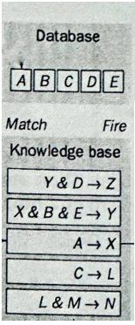
Forward Chaining Example
Let us consider the example, We have some Data in Database like A,B,C,D,E and in Knowledge base we have some IF-THEN rules by which Inference Engine will apply some logical operations to achieve a goal.
Here in this example, our goal is to by performing set of operations we will arrive at Z or we can say infer the fact Z.

Slide 14
Forward Chaining Example
First we will move forward and scan
the IF-THEN rule. If any rule matches we will fire that rule to Database.
If we observe the first rule, (Y&D → Z) here the rule cannot be fired as it says if Y and D both are present in database then fire Z. But in database we don’t have Y. So the rule cannot be valid.

Slide 15
Forward Chaining Example
If we observe the second rule, this rule cannot be fired.
But the third rule is valid can be executed. As it says, If A is present in database the fire X.
So after applying or firing the third rule now the database have X. Now again we will start scanning forward from the rule that has been fired. (Remember we cannot move backward)

Slide 16
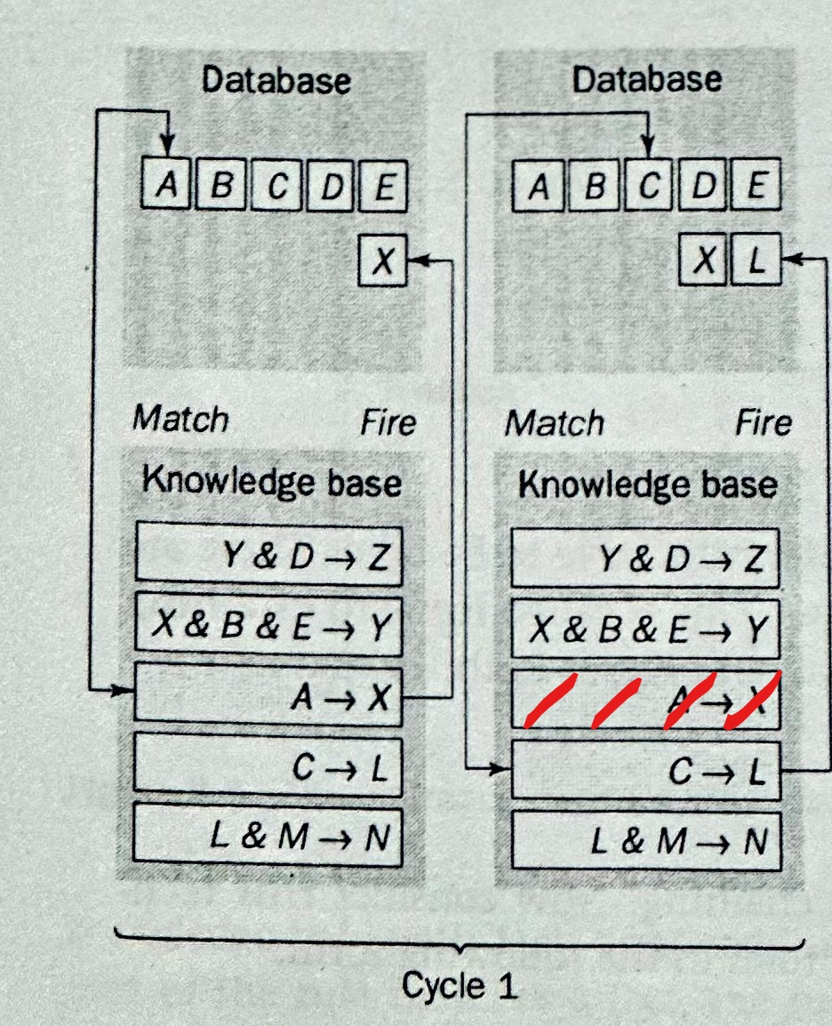
Forward Chaining Example
When moving forward we got the fourth rule that says if there is C then fire L and we can execute this rule as our database have C.
After that if we start scanning again we will have the fifth rule which is not executable.
Finally we have finished our scanning. Now we cannot go backward and scan again but we can change the cycle.
So Cycle-1 is completed and now let’s move to Cycle-2

Slide 17
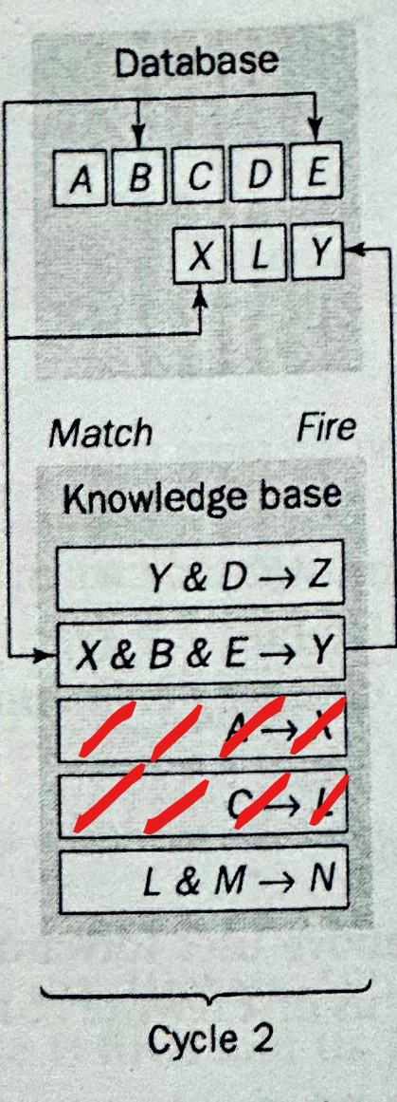
Forward Chaining Example
In Cycle-2 we will start scanning the knowledge base from the beginning but we cannot apply or fire the rules that has been already fired.
If we start scanning we will see that the first rule cannot be fired.
In the second rule we can see that if X & B & E is present then we can fire Y. So the rule is valid and executable so now in database we have Y.

Slide 18
Forward Chaining Example
Now if we start scanning again we will see that the rest of the rules are not executable. Again we have completed our scanning but still didn’t get the goal data Z. So we will move to Cycle-3.
In Cycle-3 we will start scanning the knowledge base from the beginning but we cannot apply or fire the rules that has been already fired.

Slide 19
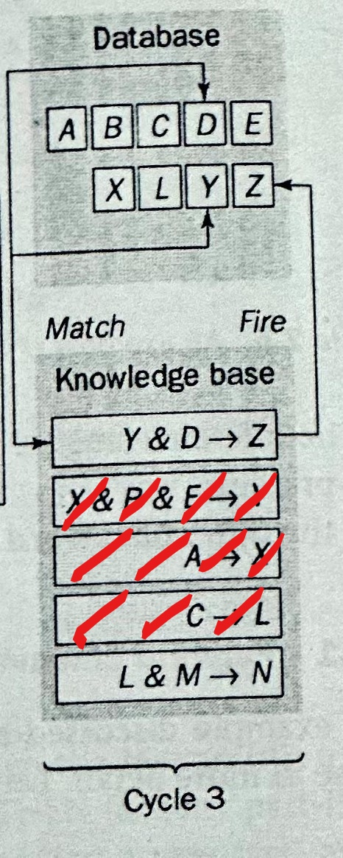
Forward Chaining Example
If we start scanning we will see that the first rule can be applied as it says if Y& D is present in database then fire Z .
So finally database contains data Z and this was our goal to be achieve.
As Inference engine has inferred the fact Z now the match-fire cycles stops because the IF part of Rule 5 (L& M →N) does not match all the facts in the database and thus it cannot be fired.

Slide 20
Disadvantages of Forward Chaining
Forward chaining is a technique for gathering information and then inferring from it whatever can be inferred. However, in forward chaining, many rules may be executed that have nothing to do with the established goal. Suppose, in our example, the goal was to determine fact Z. We had only five rules in the knowledge base and four of them were fired.

Slide 21
Disadvantages of Forward Chaining
But Rule 4: C → L, which is unrelated to fact Z, was also fired among others. A real rule-based expert system can have hundreds of rules, many of which might be fired to derive new facts that are valid, but unfortunately unrelated to the goal.
Therefore, if our goal is to infer only one particular fact, the forward chaining inference technique would not be efficient. In such a situation, Backward chaining is more appropriate

Slide 22
Backward chaining
In this, the inference system knows the final decision or goal, this system starts from the goal and works backwards to determine what facts must be asserted (declared) so that the goal can be achieved, i.e it works from goal (final decision) and reaches the initial state.
The MYCIN expert system is a real life example of how backward chaining works. This is a system that’s used in the diagnosis of bacterial infections. It also recommends suitable treatments for this type of infections.

Slide 23
Backward chaining
Backward chaining can be used in debugging, diagnostics, and prescription applications.
A simple example of forward chaining can be explained in the following sequence.
B
𝐴→𝐵
A
B is the starting point, 𝐴→𝐵 represents a fact. This fact is used to achieve a decision A.

Slide 24
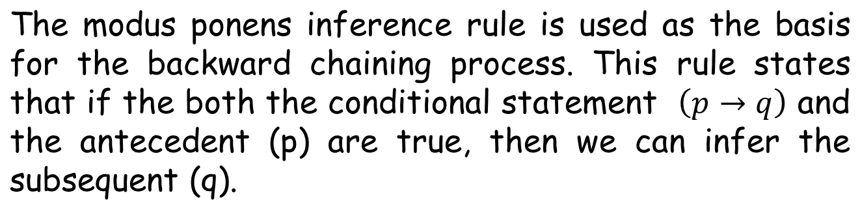
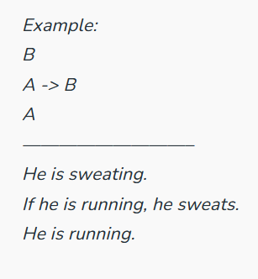
Backward chaining

Slide 25
Backward chaining
Backward chaining is the goal-driven reasoning.
In backward chaining, an expert system has the goal and the inference engine attempts to find the evidence to prove it.
First, the knowledge base is searched to find rules that might have the desired solution.
If such a rule is found and its IF (condition) part matches data in the database, then the rule is fired and the goal is proved. (this is rarely the case.)
Thus the inference engine puts aside the rule it is working with and sets up a new goal, called a sub Goal.
The inference engine repeats the process of stacking the rules until no rules are found in the knowledge base to prove the current sub-goal.

Slide 26
Backward chaining example
Here in this example our Goal is to find ‘Z’.
To find this we will search in knowledge base to find the rule that has the goal.
If that rule satisfy the ‘IF-THEN’ part then we will fire the goal to database.
Otherwise we will set up a new goal called Sub-Goal and proceed accordingly.
We will move pass by pass to find our Goal

Slide 27
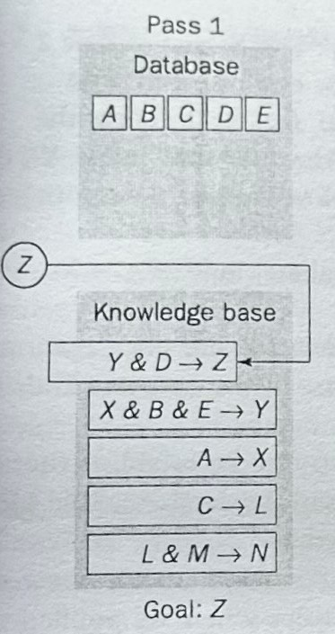
Backward chaining example
In Pass 1, the inference engine attempts to infer fact Z.
It will search the knowledge base to find the rule that has the goal.
In Rule 1 it says : Y & D -> Z. If Y and D both are in database then we can fire Z.
But Y is not present in database. So the IF part does not matches.
Now our new goal will be to find Y and search for the rule that has Y.
Move to Pass-2.

Slide 28
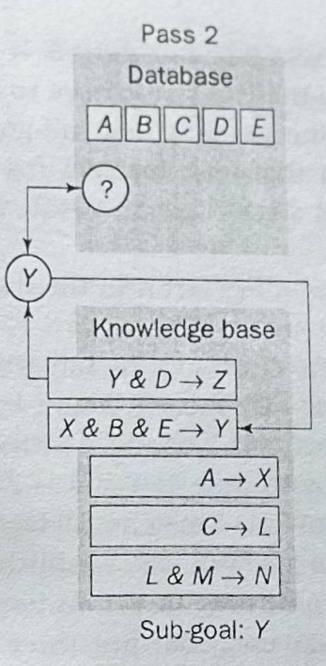
Backward chaining example
In Pass 2, the inference engine sets up to infer/find the sub-goal Y.
First it will search the database , but fact Y is not present in database.
Then It will search the knowledge base to find the rule that has the sub-goal in THEN part.
In Rule 2 ‘Y’ is present in THEN part.

Slide 29
Backward chaining example
In Rule 2 it says : X & B & E -> Y.
But as X is not present in database. So the IF part does not matches and we cannot fire sub-goal Y.
Now our new goal will be to find X and search for the rule that has X.
Move to Pass-3.

Slide 30
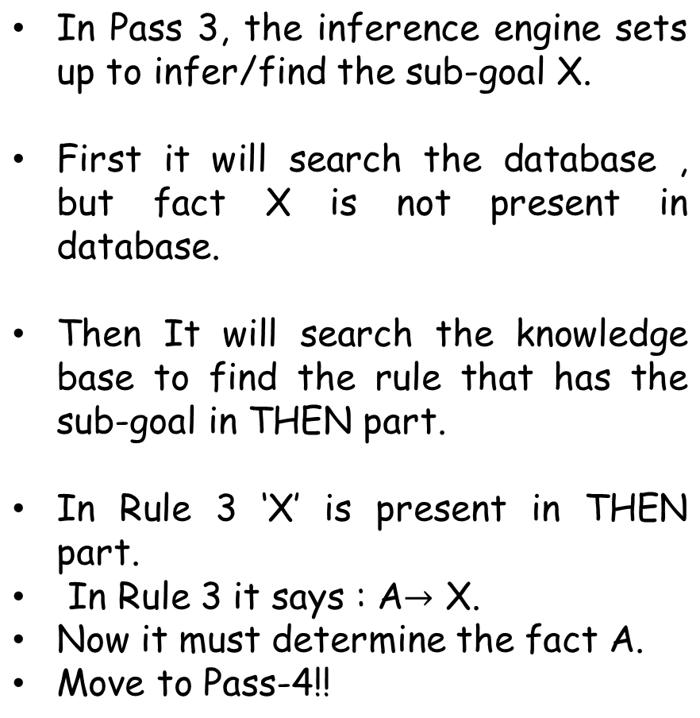
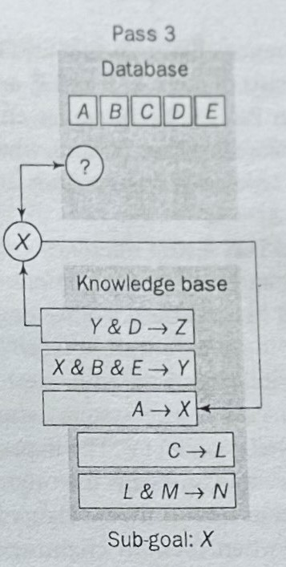
Backward chaining example

Slide 31
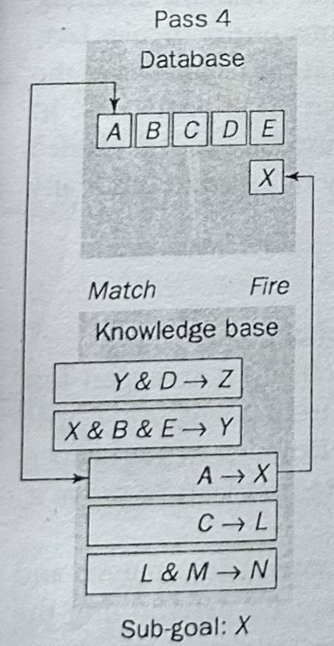
Backward chaining example
In Pass 4, the inference engine will search the database to find the fact A.
A is present in database, so Rule-3 is fired and new fact X is inferred.
Move to Pass-5!!

Slide 32
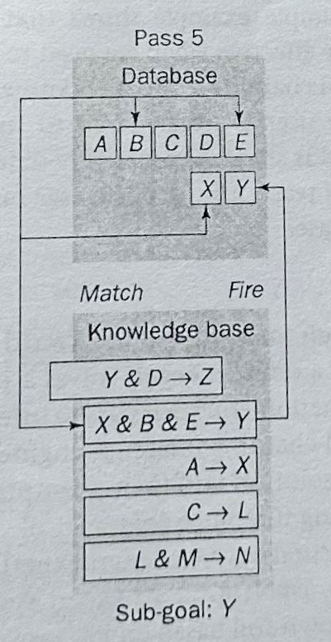
Backward chaining example
If we remember, Inference engine set up the sub-goal X to find the sub-goal Y.
As we already find the sub-goal X, now we will move backward.
In Pass 5, the inference engine returns to sub-goal Y and once again tries to execute Rule-2.
In Rule 2 it says : X & B & E -> Y.
As X,B and E are present in database so Rule-2 will be fired and new fact Y is inferred.
Move to Pass-6!!

Slide 33
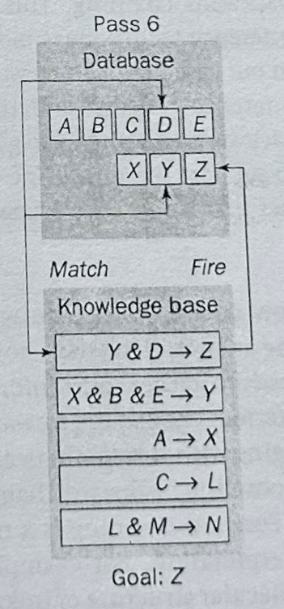
Backward chaining example
If we remember, Inference engine set up the sub-goal Y to find the goal Z .
As we already find the sub-goal Y, now we will move backward.
In Pass 6, the inference engine returns to original goal Z and tries to execute Rule-1.
In Rule 1 it says : Y & D -> Z.
As Y & D are present in database so Rule-1 will be fired and finally our goal Z is inferred.
DONE!!!

Slide 34
How do we choose between forward and backward chaining?
The answer is to study how a domain expert solves a problem. If an expert first needs to gather some information and then tries to infer from it whatever can be inferred, choose the forward chaining inference engine.
However, if your expert begins with a hypothetical solution and then attempts to find facts to prove it, choose the backward chaining inference engine.

Slide 35
End

